Slide 1


Proposed Smelter/Scoping Update Gonzaga University School of Law Wednesday, October 17, 2018 Spokane, WA
What we know. What we don’t know
University Legal Assistance
Responsible Growth * NE Washington

Slide 2
What we know
We know that PacWest Silicon (formerly known as HiTest Sand) was awarded a $350,000 Project of Statewide Significance for a proposal to build a Silicon Smelter in Pend Oreille County.
“The project aligns well with Commerce’s commitment to strengthen underserved and rural communities.”
Brian Bonlender,
Director, Dept. of Commerce

Slide 3
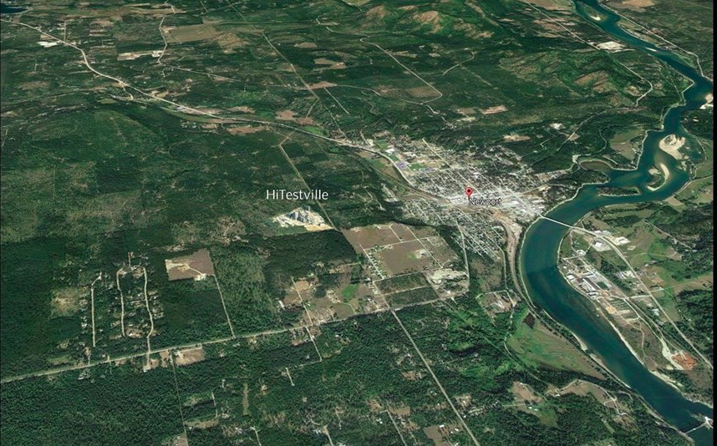
What we know
We know that PacWest Silicon wants to build a $350 million silicon metals smelter on 188 acres of public land that is not zoned for industrial use. And, we know PacWest purchased the property.

Slide 4
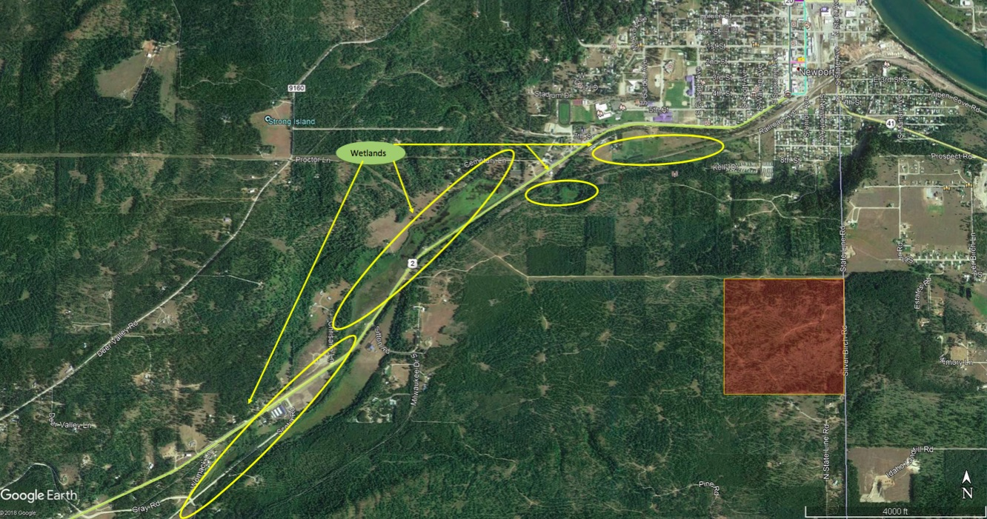
What we know
We know that PacWest purchased 4 parcels of Public Land owned by POC Public Utility District for $300,000. Land PUD bought in 1996, minus one small parcel, for $600,000.

Slide 5
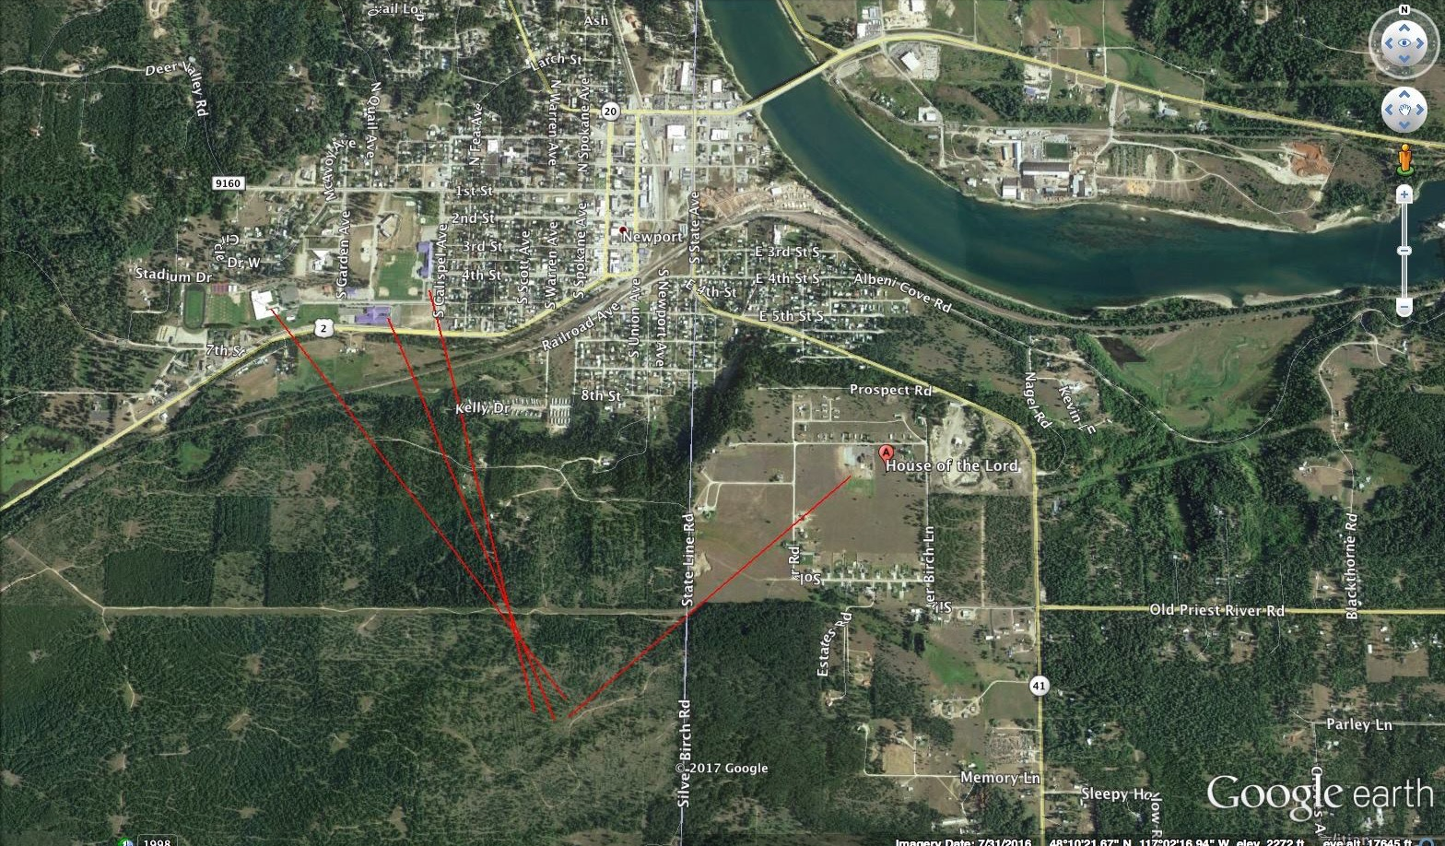
What we know
We know that the proposed silicon metal smelter will be within 1 mile of downtown Newport, WA and less that ¾ miles from Oldtown, Idaho.

Slide 6
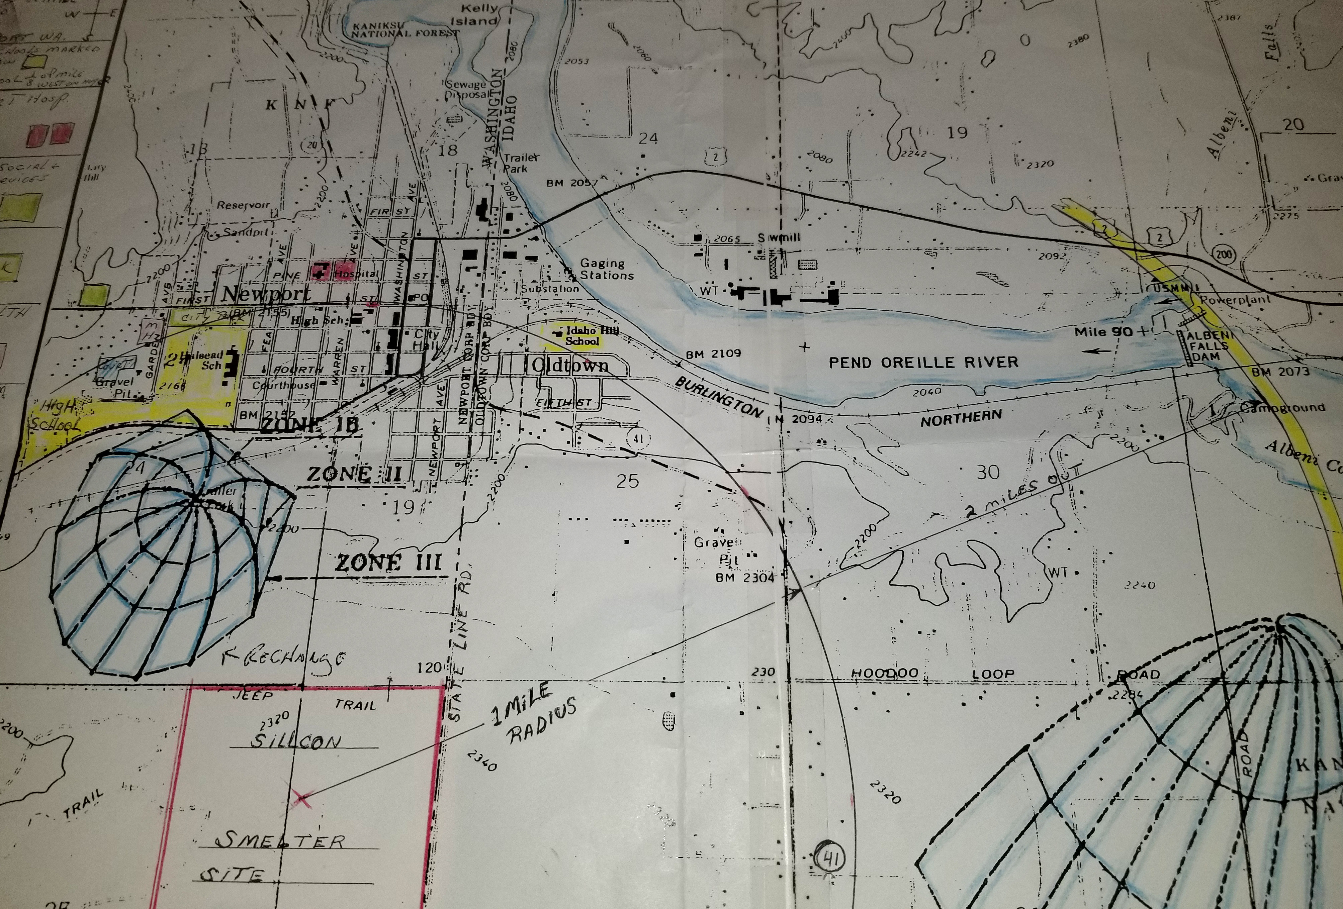
What we know
We know that the proposed silicon metal smelter would sit a few hundred meters uphill from the City of Newport’s water recharge zone and new wells.

Slide 7
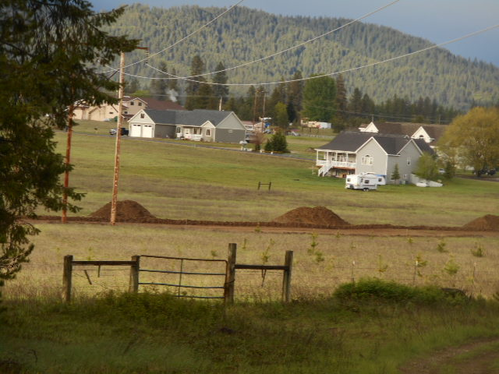
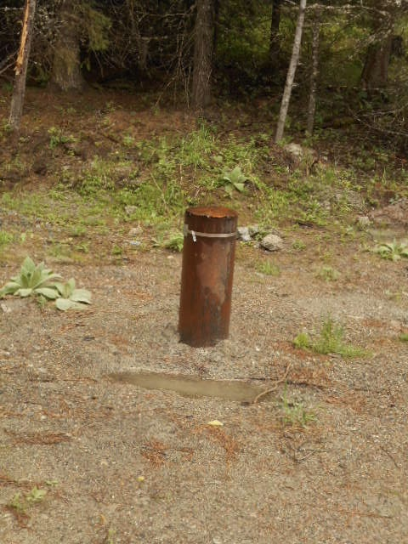
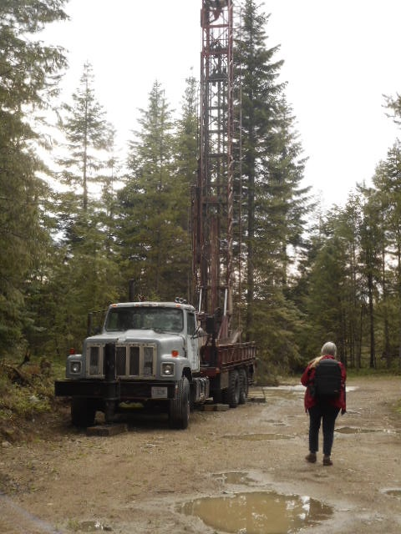
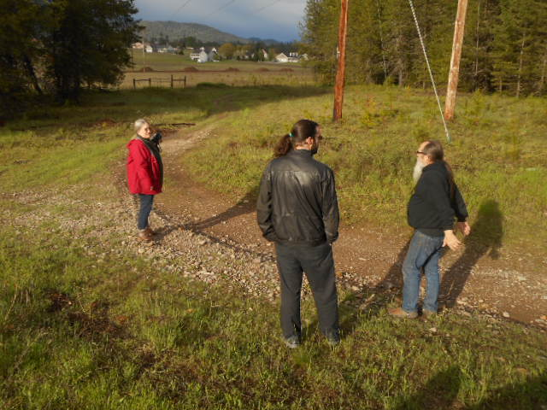
What we know

Slide 8
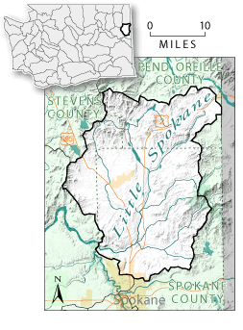
What we know
We do know that the proposed silicon metals smelter will sit on top of the the Little Spokane River Aquifer Basin and the Pend Oreille River ground water basin.

Slide 9
What we know

Slide 10
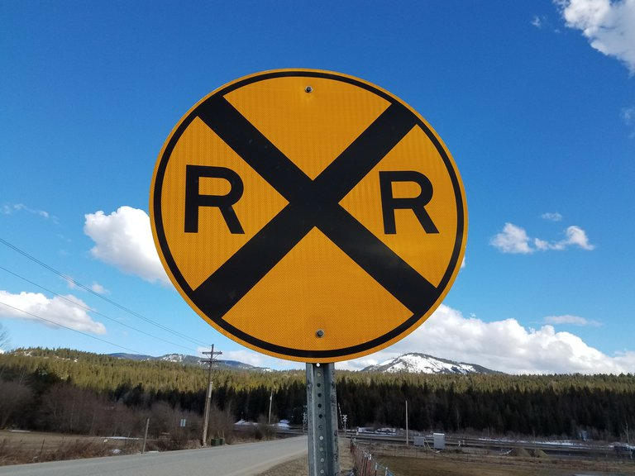
What we know
We do know that PacWest wants, to run a 2.5 to a 3.5 mile spur line up the to the South Bench to haul in the raw materials and take out the bi-products and silicon.

Slide 11
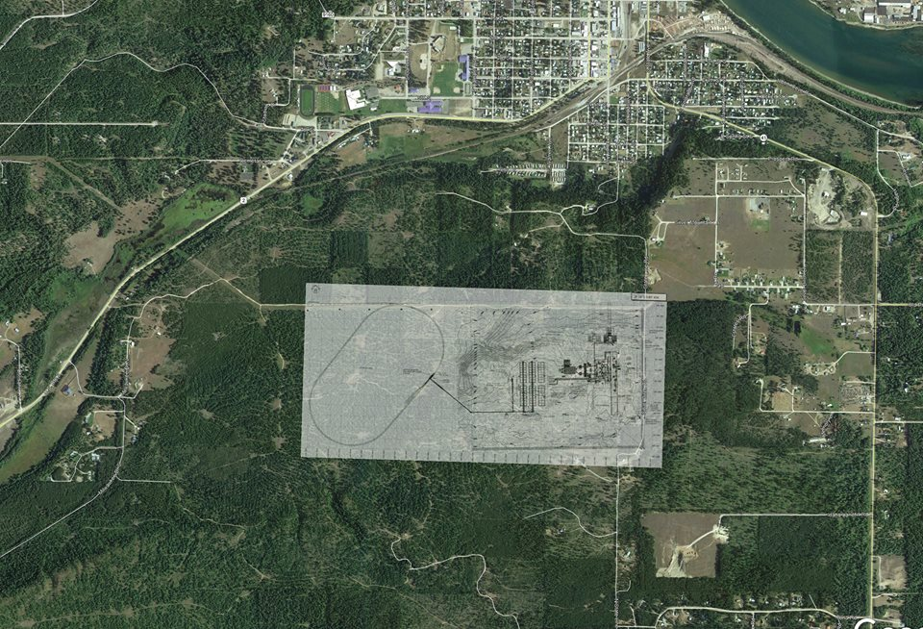
What we know
We know about how far out the loop railroad will have to go in order to get up the grade to the location of the proposed silicon metal smelter.

Slide 12
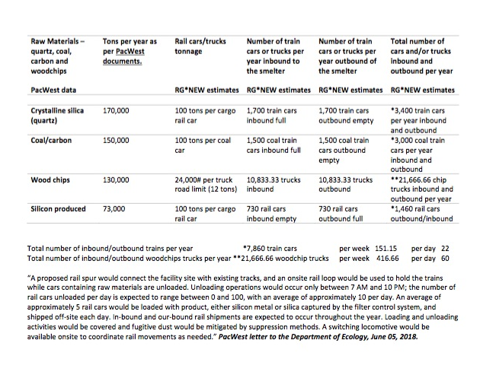
We know how many tons per year of raw materials will be railed/truck in. We know the number of trains and trucks that will be added to our road and track system.

Slide 13
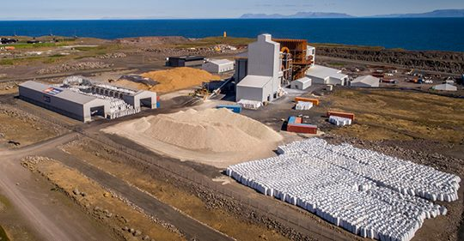
What we know
We know the proposed silicon metal smelter will look very similar to this Iceland silicon metal smelter

Slide 14
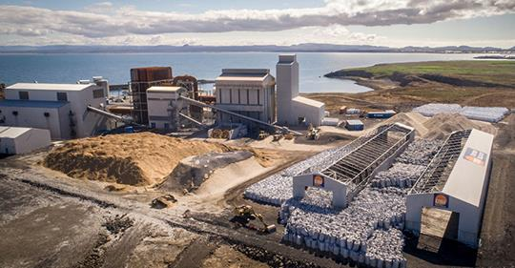
What we know

Slide 15
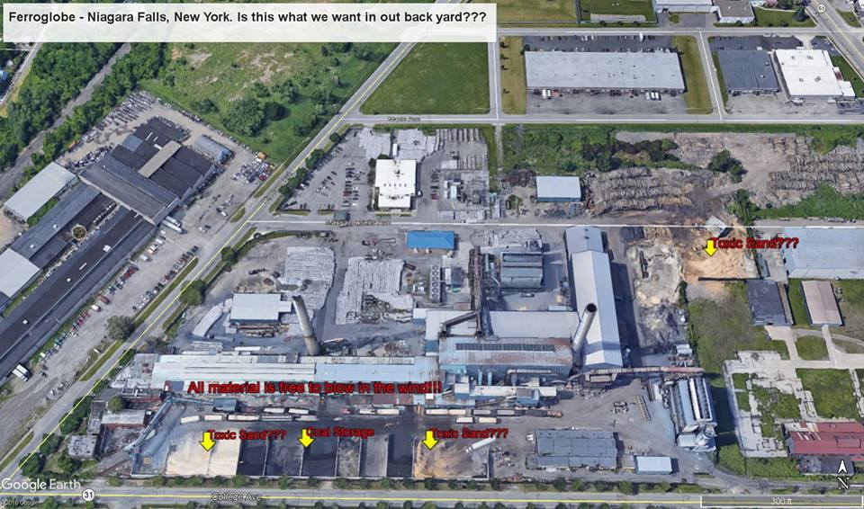
What we know
We know that it has been compared to the Niagara Falls silicon metals smelter.

Slide 16
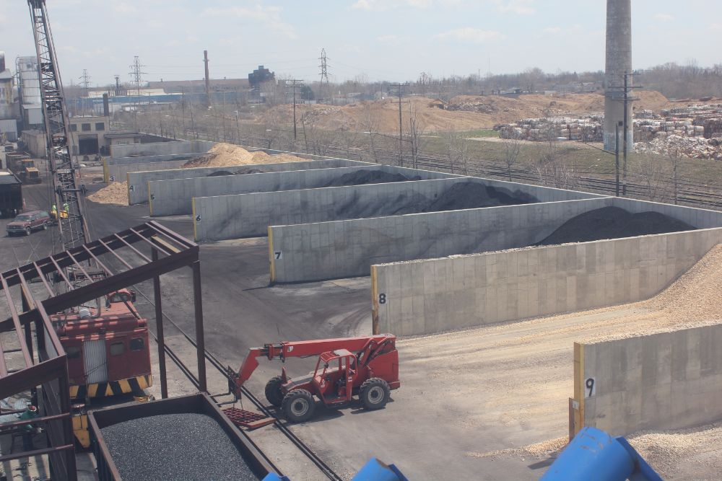
What we know
Niagara Falls silicon metal smelter. The holding bins for the raw materials – coal, crystalline silica, carbon, and wood chips.

Slide 17
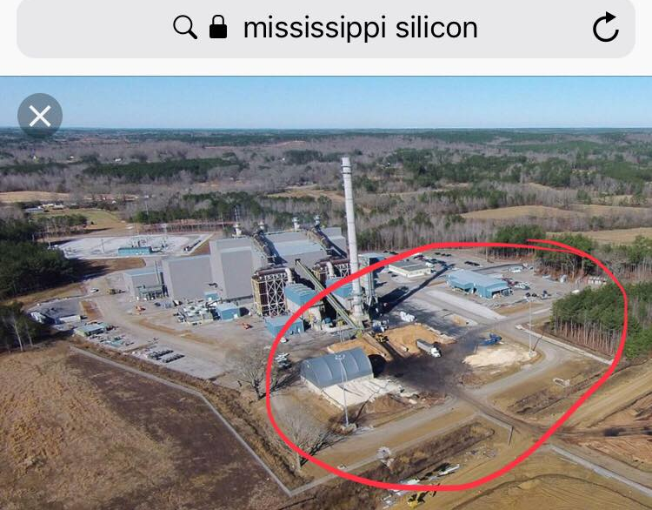
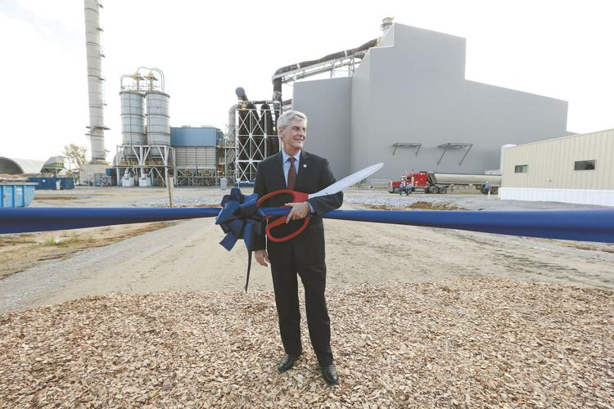
Burnsville, Mississippi Silicon Chemical Smelter Grand Opening Nov. 29, 2015.

Slide 18
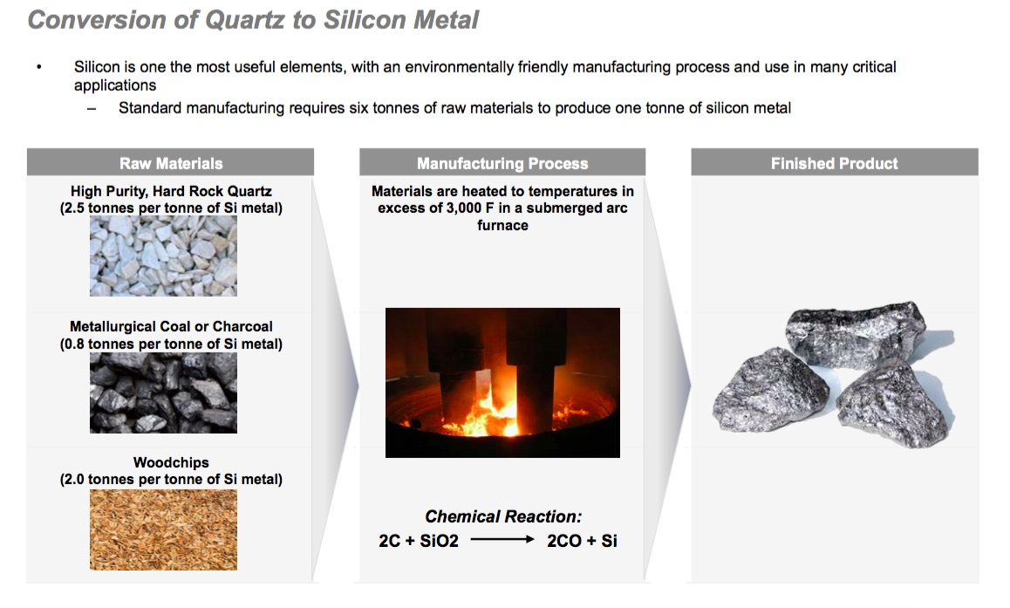
What we know
We know the chemical process of converting one metal, crystalline silica, to a whole new metal, silicon metal.

Slide 19
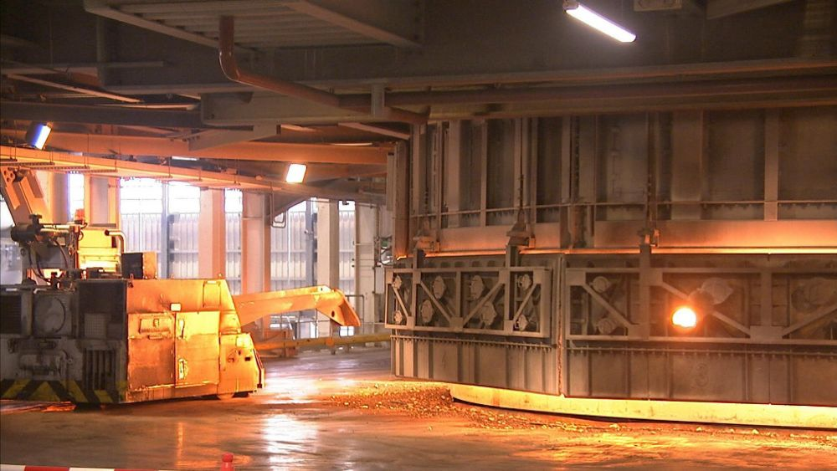
What we know
We know what the inside of a silicon metal smelter looks like. This is one of the sub arc furnaces in the PCC silicon smelter in Iceland

Slide 20
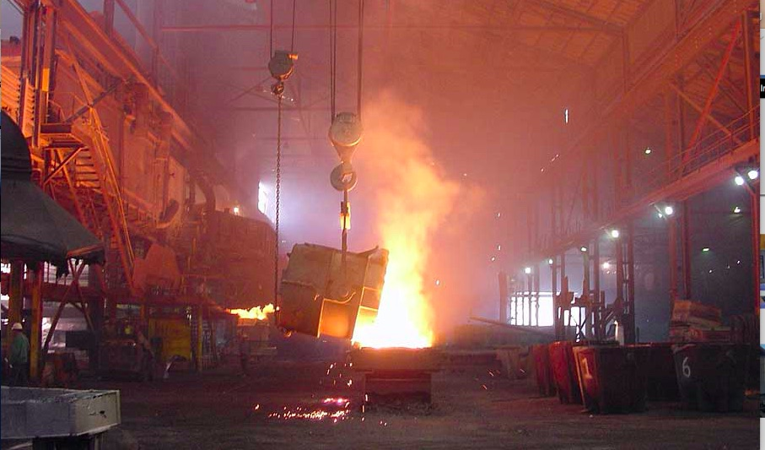
What we know
We know that this the silicon smelter in Beverly, Ohio. We know those are toxic fugitive emissions.

Slide 21
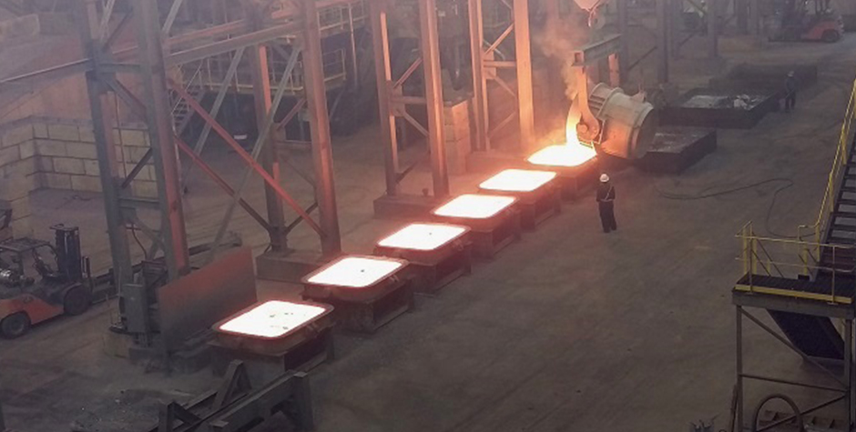
What we know
We know that this is hot molten metals being poured in the molds.

Slide 22
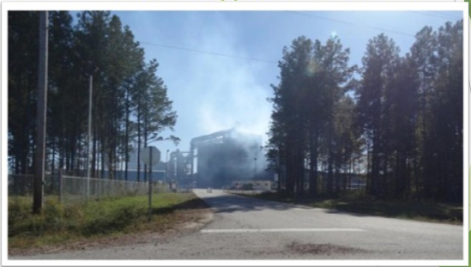
What we know
We know that this is the Burnsville, Mississippi silicon smelter spewing out fugitive emissions from the building.
Roger Castle photo,
2017

Slide 23
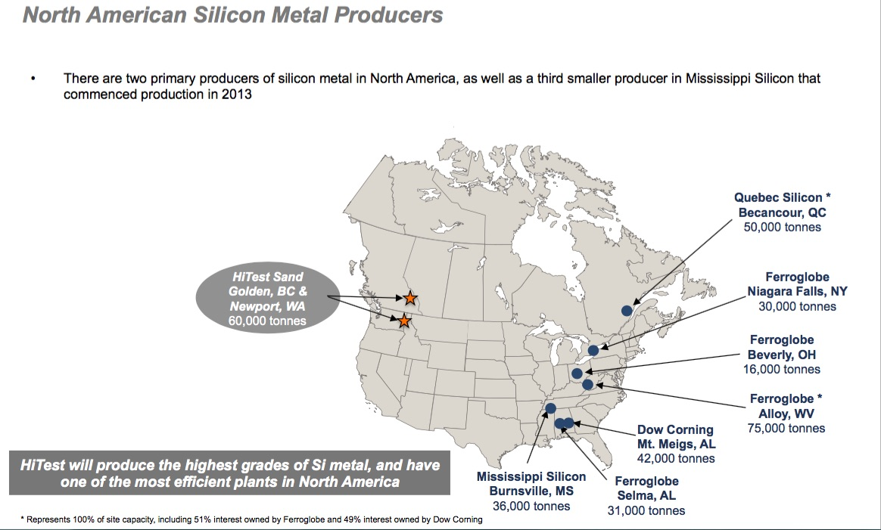
What we know
We know that there are seven silicon metal smelters in North America. The proposed Newport silicon metal smelter will be the second largest producer of silicon at 73,000 tons per year.

Slide 24
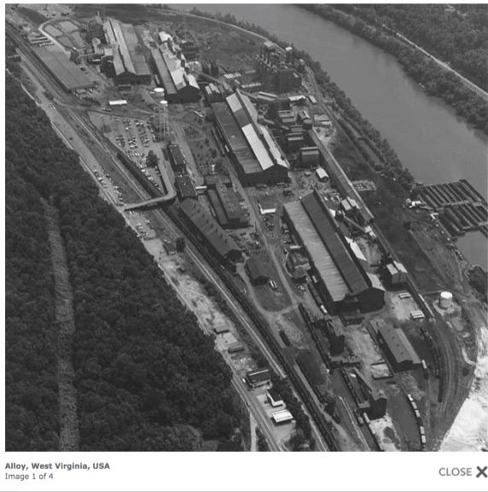
What we know
The Ferroglobe silicon metal smelter in Alloy, West Virginia is the largest producer of silicon metal in North America at 75,000 tons per year.

Slide 25
What we do know
We know that the proposed Newport silicon metal smelter will produce this amount of regulated pollution with 1 stack and 2 furnaces; double the numbers with 2 stacks and four furnaces.
320,256 tpy of regulated greenhouse gases
760 tpy of regulated sulfur dioxide (acid rain)
601 tpy of regulated carbon dioxide
Carbon Monoxide
89 tpy regulated particulate matter PM10
85 tpy of regulated particulate matter PM2.5
20 tpy of regulated VOC
Pac West Silicon, LLC. data

Slide 26
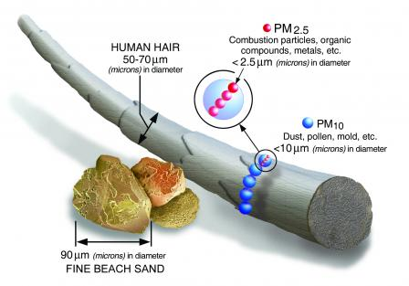
Particulate Matter 174 tons per year
Exposure to such particles can affect both your lungs and your heart. Numerous scientific studies have linked particle pollution exposure to a variety of problems, including:
premature death in people with heart or lung disease
nonfatal heart attacks
irregular heartbeat
aggravated asthma
decreased lung function
increased respiratory symptoms, such as irritation of the airways, coughing or difficulty breathing.
People with heart or lung diseases, children, and older adults are the most likely to be affected by particle pollution exposure.
US EPA
United States Environmental Protection Agency

Slide 27
Carbon Dioxide 601 tons per year
CO is a colorless, odorless gas that can be harmful when inhaled in large amounts. CO is released when something is burned.
Breathing air with a high concentration of CO reduces the amount of oxygen that can be transported in the blood stream to critical organs like the heart and brain.
At very high levels, which are possible indoors or in other enclosed environments, CO can cause dizziness, confusion, unconsciousness and death.
US EPA
United States Environmental Protection Agency

Slide 28
Sulfur Dioxide 760 tons per year
Short-term exposures to SO₂ can harm the human respiratory system and make breathing difficult. Children, the elderly, and those who suffer from asthma are particularly sensitive to effects of SO₂.
SO₂ emissions that lead to high concentrations of SO₂ in the air generally also lead to the formation of other sulfur oxides (SO_{x}). SO_{x} can react with other compounds in the atmosphere to form small particles. These particles contribute to particulate matter (PM) pollution: particles may penetrate deeply into sensitive parts of the lungs and cause additional health problems.
At high concentrations, gaseous SOx can harm trees and plants by damaging foliage and decreasing growth.
SO₂ and other sulfur oxides can contribute to acid rain which can harm sensitive ecosystems.
US EPA
United States Environmental Protection Agency

Slide 29
Greenhouse Gases 320,256 tons per year
Gases that trap heat in the atmosphere are called greenhouse gases.
The largest source of greenhouse gas emissions from human activities in the United States is from burning fossil fuels for electricity, heat, and
(22 percent of 2016 greenhouse gas emissions) – Greenhouse gas emissions from industry primarily come from burning fossil fuels for energy, as well as greenhouse gas emissions from certain chemical reactions necessary to produce goods from raw materials.
US EPA
United States Environmental Protection Agency

Slide 30
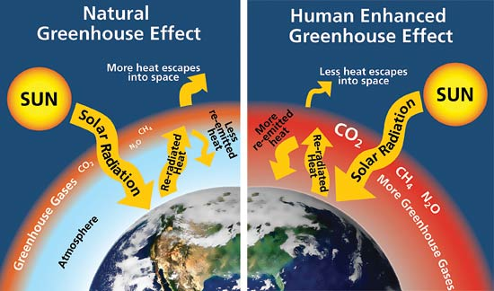
Greenhouse Gases 320,256 tons per year
Carbon dioxide (CO₂)
Methane (CH₄)
Nitrous oxide (N₂O)
Nitrous oxide (N₂O)
Fluorinated gases
Hydrofluorocarbons, perfluorocarbons, sulfur hexafluoride, and nitrogen trifluoride are synthetic, powerful greenhouse gases that are emitted from a variety of industrial processes.
US EPA
United States Environmental Protection Agency

Slide 31
Volatile Organic Compounds 20 tons per year
Volatile organic compounds (VOCs) are emitted as gases from certain solids or liquids. VOCs include a variety of chemicals, some of which may have short- and long-term adverse health effects. Concentrations of many VOCs are consistently higher indoors (up to ten times higher) than outdoors. VOCs are emitted by a wide array of products numbering in the thousands.
There are about “200 different VOC compounds emitted from the PCC Silicon plant in Iceland including some that can create odour.”
Formaldhyde was detected in the VOC exhaust from the PCC Silicon plant but not from the residential areas.
“Anhydride was then measured separately by NILA and a considerable amount was found at the plant inside the baghouse, but the actual concentration of anhydride was uncertain.”

Slide 32
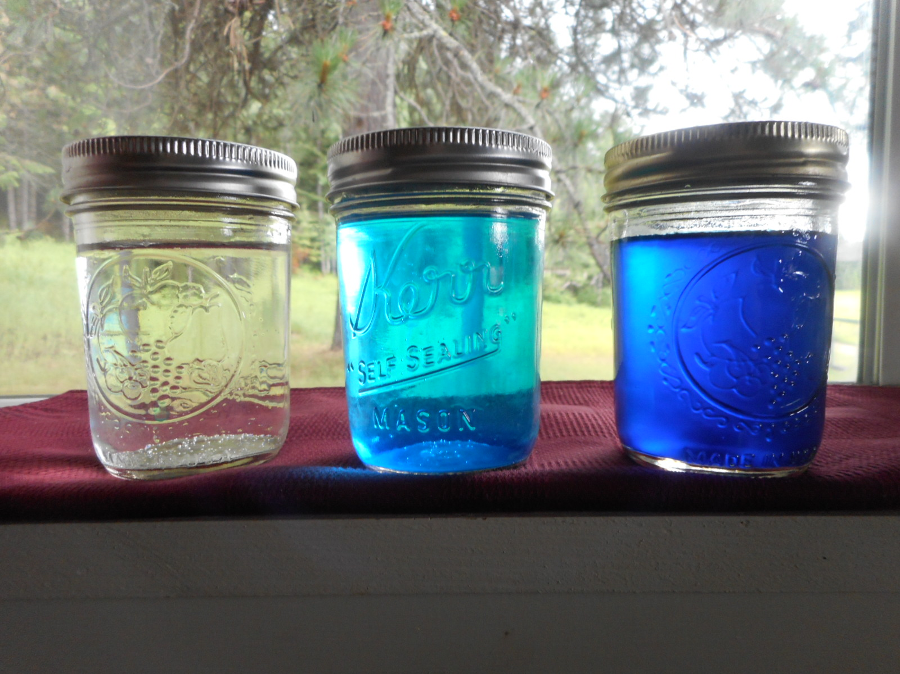
What we know
Difference among what the people want; what DOE wants and what PacWest Silicon, LLC. wants.
No emissions
Regulated emissions
No regulated emissions/fugitive
We the People
Department of Ecology
PacWest Silicon, LLC.
Clean air, water and environment
Unregulated pollution
DOE Regulated Pollution

Slide 33
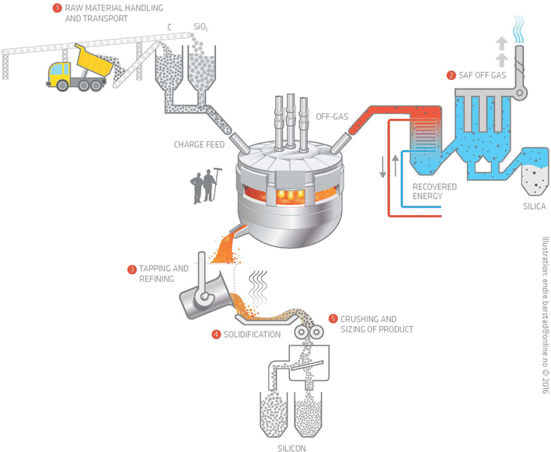
What we know
Points of Fugitive Emissions during the process
Raw Material transport and handling
SAF (submerged arc furnance) Off Gas
3. Tapping and refining
4. Solidification
5. Crushing & sizing

Slide 34
What we know
PacWest Silicon, LLC diagram

Slide 35
What we know
Acid rain results when sulfur dioxide (SO₂) and nitrogen oxides (NO_{X}) are emitted into the atmosphere and transported by wind and air currents.
The SO₂ and NO_{X} react with water, oxygen and other chemicals to form sulfuric and nitric acids. These then mix with water and other materials before falling to the ground.
While a small portion of the SO₂ and NO_{X} that cause acid rain is from natural sources such as volcanoes, most of it comes from the burning of fossil fuels.
US EPA
United States Environmental Protection Agency
PacWest Silicon, LLC.

Slide 36
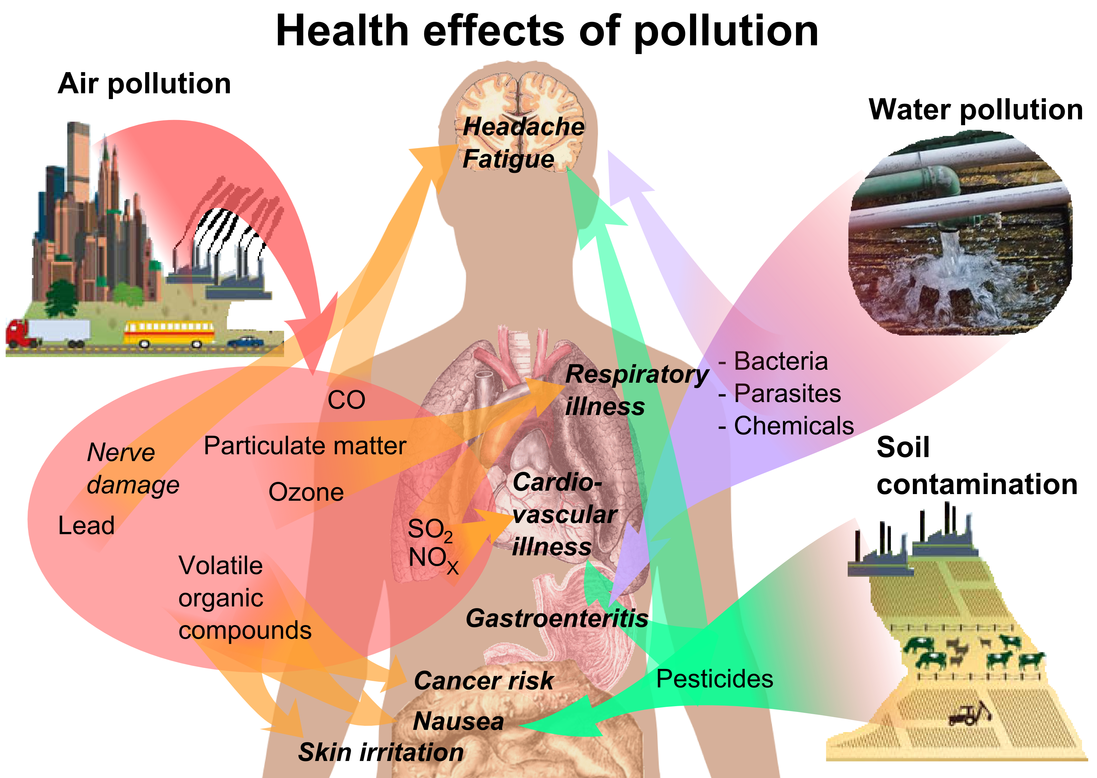
What we know

Slide 37
What we know
Silicosis is caused by inhalation of unbound (free) crystalline silica dust. Over time:
Involve all of the lungs;
dyspnea,
hypoxemia,
pulmonary hypertension, respiratory impairment.
No effective treatment exists except supportive care and, for severe cases, lung transplantation.

Slide 38
What we know
Other factors
Noise light/glare increase in traffic infrastructure
Decrease in property values rural becomes urban industrial
Emergency services burn-trauma schools crime jobs
Flora and fauna vibration tourism housing corporate welfare
Rare species competition for workers storm water potable water
Putting all your eggs in one basket fisheries 24/7 operations
over allocation of water and other resources
1 traffic light in all of Pend Oreille County

Slide 39

RG * NEW Contact info:
e-mail: responsiblegrowthnew@gmail.com
website: www.rgnew.org
Responsible Growth * NE Washington
P.O. Box 317
Newport, WA 99156

Slide 40
DOE Contact information
Comment by mail:
Grant Pfeifer, Regional Director Department of Ecology, Eastern Regional Office 4601 N. Monroe St. Spokane, WA 99205
Comment on-line:
http://sepa.ecology.commentinput.com/?id=p4CsA
By Phone:
Phone — 509-329-3400 Fax — 509-329-3596 Office hours — 8 AM - 5 PM

