Slide 1
SEPA and the Commenting Process
University Legal Assistance –
Environmental Law and Land Use Clinic

Slide 2
What is SEPA?
Annie Bell and Melissa Murdock – ULA Interns

Slide 3
What is SEPA?
SEPA is the State Environmental Policy Act and applies to decisions by every state agency, county, city, port, and special district within Washington.
After some sort of proposal is made, an agency is identified as the “Lead Agency”.
The Lead Agency is responsible for identifying and evaluating the potential adverse environmental impacts of the proposal.
The Lead Agency determines whether impacts are likely to be significant. This is called the “Threshold Determination” which can result in three options:
A Determination of Nonsignificance (DNS)
A Mitigated Determination of Nonsignificance (MDNS)
A Determination of Significance (DS).
A DS requires the preparation of an Environmental Impact Statement (EIS).
In most cases the Threshold Determination is sent to other agencies, tribes, and the public for their review.

Slide 4
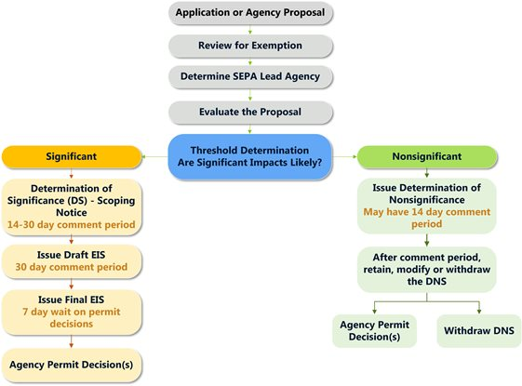
Where is the Project at in the SEPA Process?
The Department of Ecology (DOE) has been selected as the Lead Agency for the proposed smelter project in Newport, WA.
Both the applicant and the DOE have agreed that there is a Determination of Significance (DS).
The DOE is currently accepting comments from the public about what the “scope” of the Environmental Impact Statement (EIS) will be.

Slide 5
Why are Scoping Comments Important?
Only the aspects that are brought up in public comments, by PacWest, or by the Department of Ecology can be considered in the Environmental Impact Statement (EIS).
If there is any aspect of the environment you want considered, include it!
If nobody brings up an important aspect, it may not be considered in the EIS.
Should there be a reason to appeal the decision of the Department of Ecology to a court, no additional information will be included in the process.
A Judge can only look at what is in the “record” which means everything that the DOE had available at the time it made its decision.
If it is later discovered that there was an important environmental impact, but the DOE did not have any information about it when it made its decision, that additional information is very unlikely to be made available to the court as a reason to appeal the DOE’s decision.

Slide 6
So What Should be Included in Comments?
EVERYTHING!

Slide 7
How to Write an Effective Public Comment
Rick Eichstaedt – Director, Environmental Law Clinic

Slide 8

Why comment?
Public participation matters. Democratic, legal, and management principles justify why public comments make a difference in regulatory policy. Public participation is an essential function of good governance.
Influence decision
Show Ecology and proponent the scope of opposition

Slide 9
Tips for Commenting
State who you are, where you live, why you care about this proposal – include relevant personal and/or professional experiences.
State how this will impact you, your property, your business.
Always submit written comments even if submitting oral comments.
Define your objectives: Before you start writing, ask yourself: What do you hope to achieve through your comment? Are you trying to stop the action or to catch and correct factual errors or data gaps? You should write your comment in a way that best supports your objectives.
Use clear organization, formatting, and language: You should use subject headings throughout your comment to draw attention to key points. Remember that Ecology will be flooded with comments and may have to review each set quickly.
Suggest solutions and alternatives.
Provide supplemental information to support your case, if needed: If you have access to any facts, reports, or articles that support your comment, provide a copy.
Request to be included on any future opportunities for public comment and request a copy of the response to your comments.

Slide 11
Issues to Consider for Comments

Slide 12
The SEPA process is starting too early.
Regulations that govern Ecology’s implementation of SEPA, WAC 197-11-055, state that the SEPA process should begin when there is a proposal to evaluate – a proposal exists “when an agency is presented with an application or has a goal … the environmental effects can be meaningfully evaluated.”
There is no application that has been submitted for the smelter and Ecology cannot have a goal of building a smelter – building a polluted industrial site is outside the agency’s statutory authority.
It is unclear to the public why Ecology is so zealous to accommodate this Canadian corporation who seeks to build a significant pollution source is our region.

Slide 13
Effect on local environment and culture.
By its nature, the smelter will emit carbon monoxide, carbon dioxide, nitrogen oxide, sulfur dioxide, and silica dust. These substances are known to contribute to acid rain and associated human health issues.
The smelter will impact a small rural community and have significant impacts on the Kalispel Tribe.
From a global perspective, the silicon smelter will become one more contributor to greenhouse gases accelerating the onset of climate change. Emissions data recently disclosed in PacWest’s Draft PSD Modeling state that the smelter would generate 320,000 tons of greenhouse gases, 760 tons of sulfur dioxide, and 700 tons of nitrogen oxides each year.
This facility would be the State’s 5th largest emitter of sulfur dioxide, 12th largest emitter of nitrogen oxides, and 15th largest of emitter of greenhouse cases.

Slide 14
Effect on local environment and culture.
There are significant impacts associated with water use. At the Sept. 11, 2017, meeting in the Newport City Council Chambers, PacWest said that 300 gallons of water per day would be needed for the proposed smelter. Later estimates were reported to be about 8,000 gallons per day. In January 2018, the company requested 240,000 gallons of water per day from City of Newport.
Use of ground water will impact instream flows in the Spokane River.

Slide 15
Transportation Impacts
Truck transportation of raw materials is also an area of concern, even though the actual number of delivery vehicles per day has come under dispute. PacWest estimates daily materials delivery at 37 trucks per day. This will impact the City of Newport in the form of noise and fossil fuel pollution, and wear and tear on the highways and Newport’s roads.

Slide 16
Land Use
The PacWest site is currently zoned as public lands and located outside of the Newport Urban Growth Area. The Growth Management Act generally prohibits industrial development outside of an urban growth area in rural areas and prohibits cities from providing water and sewer services.

Slide 17
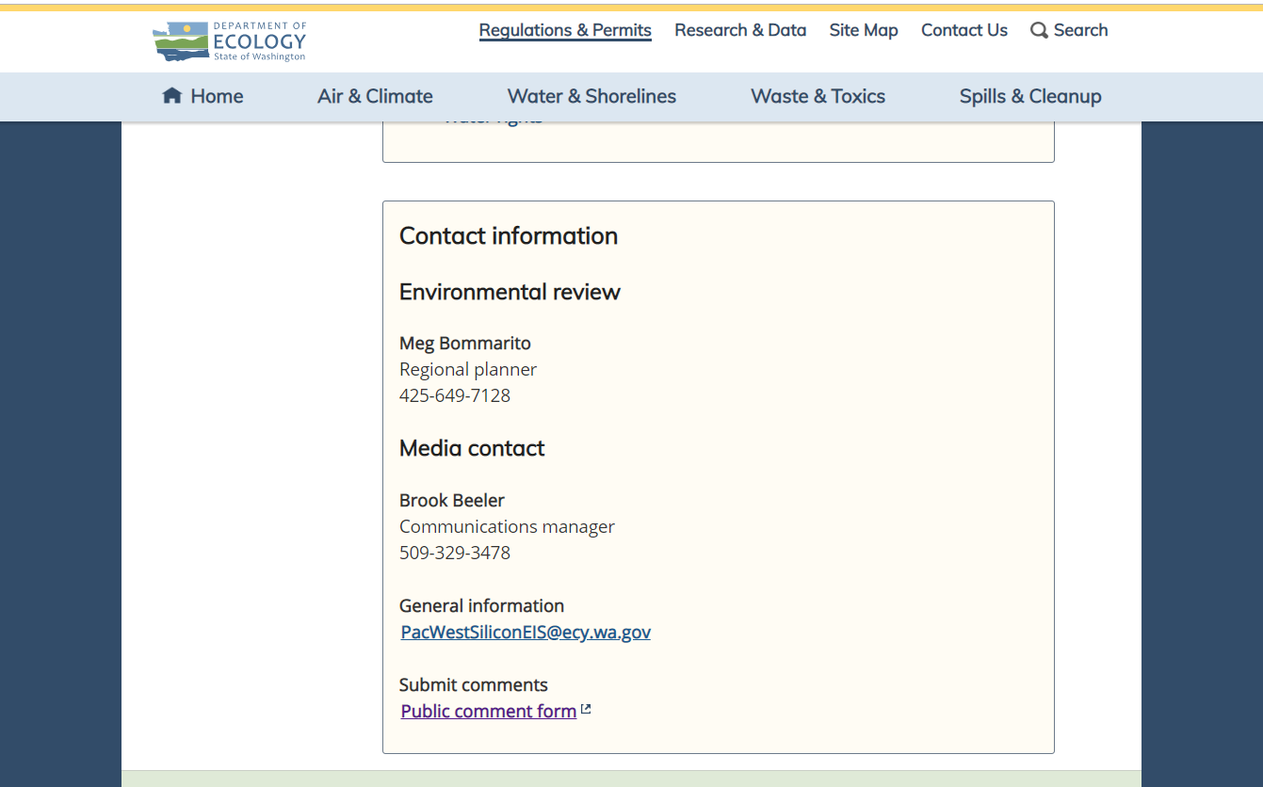
How Can I Submit a Public Comment?
Handwrite a public comment and mail to:
Grant Pfeifer, Regional Director
Department of Ecology, Eastern Regional Office
4601 N. Monroe St.
Spokane, WA 99205
Email a comment to PacWestSiliconEIS@ecy.wa.gov
State "Scoping Comment" in the RE line.
Submit a written comment online on the Department of Ecology’s Website:
http://sepa.ecology.commentinput.com/?id=p4CsA
It is also easily available to find by Googling “Department of Ecology Newport Smelter”
Select the first result
Scroll to the bottom of the page to
find “Submit a Public Comment” link

Slide 18
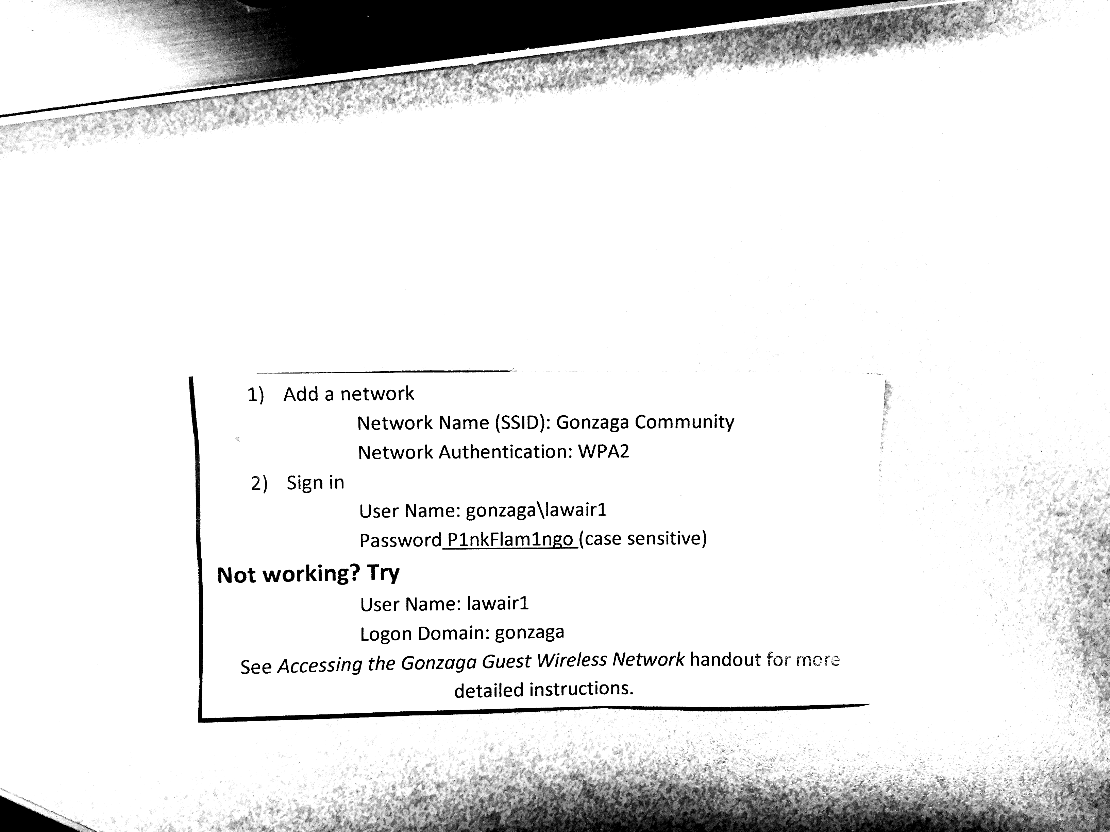
Let Us Help!
If you have a laptop with you and available, connect to the WiFi:
Or, you can submit a written comment with our pre-printed letters. We will pay for postage, and they are available now.

