Slide 1
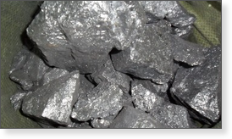
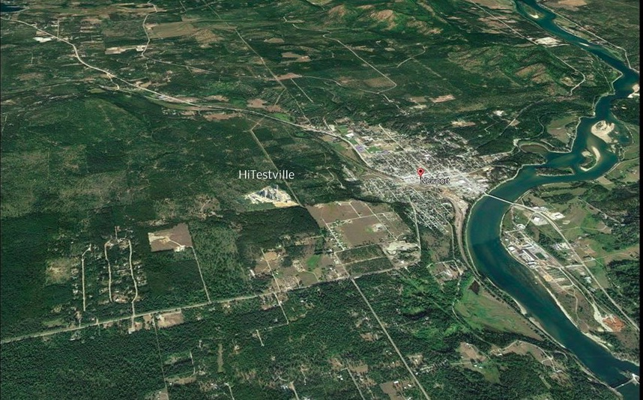
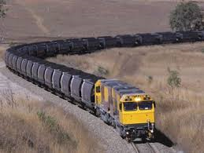
Recipe for a Silicon Metal Ingot
First you will need 188 acres of forest land in Pend Oreille County.
And, a $350 million silicon metal smelter
Plus, the backing and financial support of the local, state and federal governments.
You will also need a railroad spur line running through wetlands/forestlands and agricultural lands to bring in the ingredients for the ingot: 170,000 tpy of crystalline silica; 150,000 tpy of coal/carbon; 130,000 tpy of wood chips.
Plus, the spur line in order to get out the 73,000 tpy of silicon produced.

Slide 2
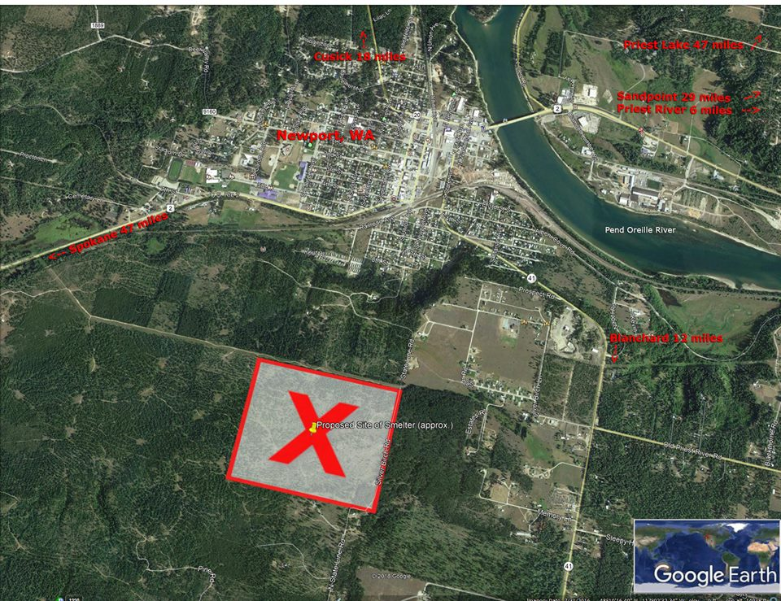
Ingredients for a Silicon Metal Ingot
Step 1: Mix 766,131 tons per year of regulated greenhouses gases into the purest air in Washington.
Step 2: Continue to add 649 tpy of regulated sulfur dioxide to the atmosphere until you have the consistency of acid rain;
Step 3: For flavor add 307 tpy of regulated carbon dioxide;
Step 4: For a bit of spice add 2660 tpy of regulated carbon monoxide;
Step 5: Throw into the above mixture 1351 tpy of regulated nitrogen oxide;
Step 6: Seasoning will include 110 tpy of PM, PM2, & PM10;
Step 7: For good measure finish off the recipe with 90 tpy of regulated VOC.
Step 8: The fugitive gas ingredients will only enrich the ingot;
Final Step: Bake at 3,000 degrees F in two electric furnaces with one stack using coal, carbon, wood chips and crystalline silica.
Release the combination of ingot-making gases 0.9kilometers from your community, homes, businesses, families, schools, hospitals, rivers, lakes, water sources, gardens, wild animal and fish habitats.

Slide 3
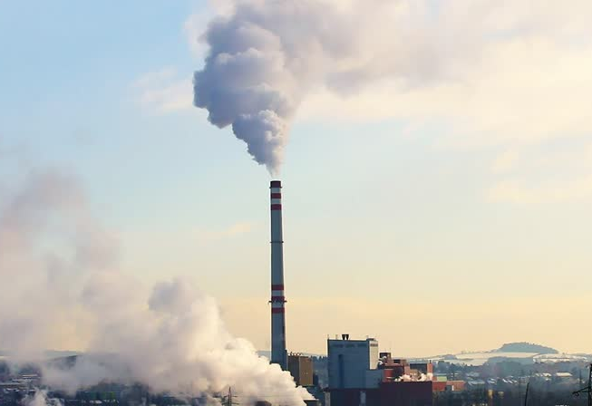
Ingredients for a Silicon Metal Ingot
Step 1: Mix 766,131 tons per year of regulated greenhouses gases into the purest air in Washington.
Step 2: Continue to add 649 tpy of regulated sulfur dioxide to the atmosphere until you have the consistency of acid rain;
Step 3: For flavor add 307 tpy of regulated carbon dioxide;
Step 4: For a bit of spice add 2660 tpy of regulated carbon monoxide;
Step 5: Throw into the above mixture 1351 tpy of regulated nitrogen oxide;
Step 6: Seasoning will include 110 tpy of PM, PM2, & PM10;
Step 7: For good measure finish off the recipe with 90 tpy of regulated VOC.
Step 8: The fugitive gas ingredients will only enrich the ingot;
Final Step: Bake at 3,000 degrees F in two electric furnaces with one stack using coal, carbon, wood chips and crystalline silica.
Release the combination of ingot-making gases 0.9kilometers from your community, homes, businesses, families, schools, hospitals, rivers, lakes, water sources, gardens, wild animal and fish habitats.

Slide 4
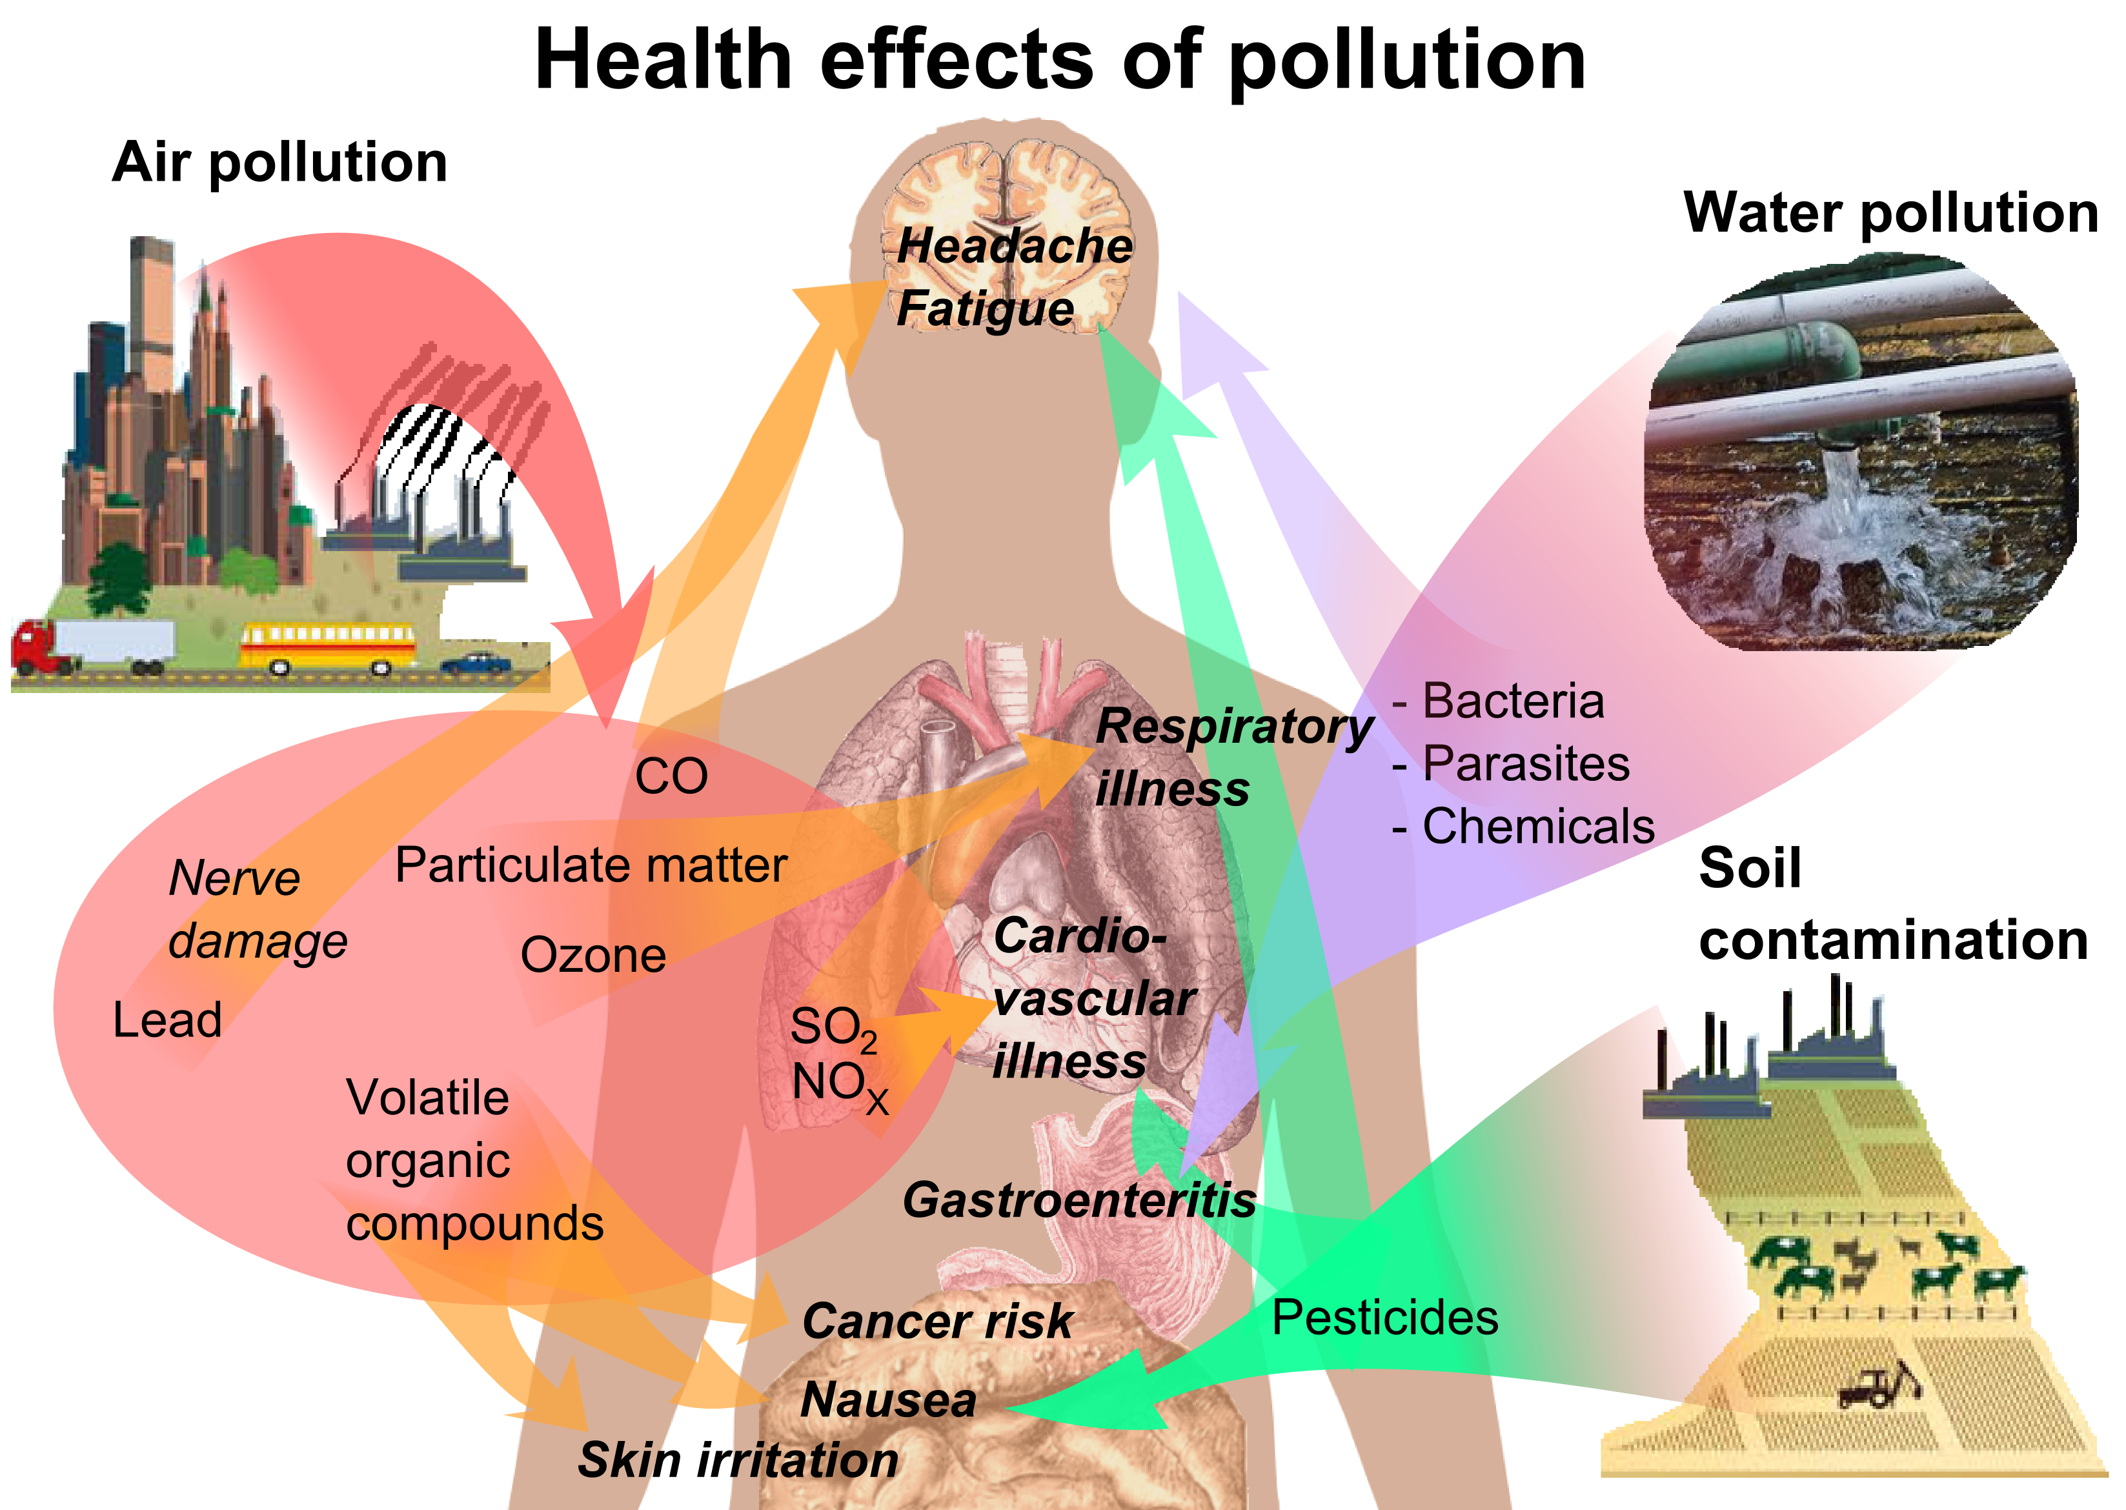
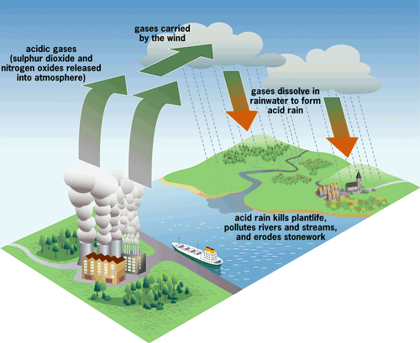
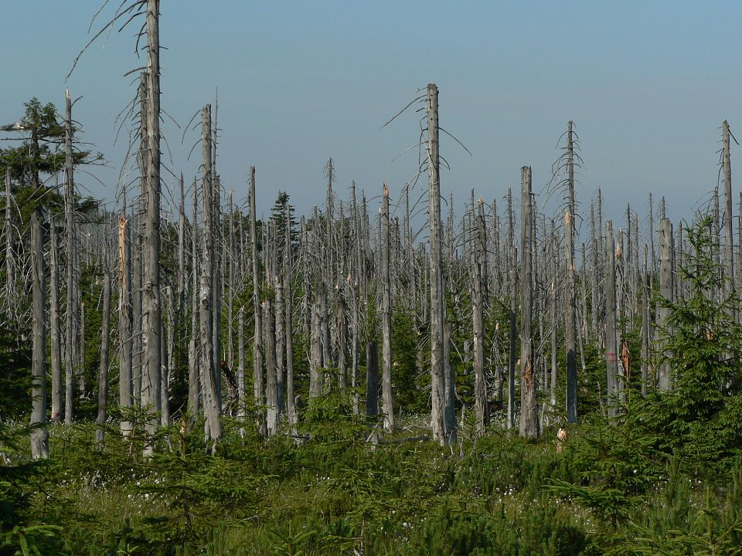
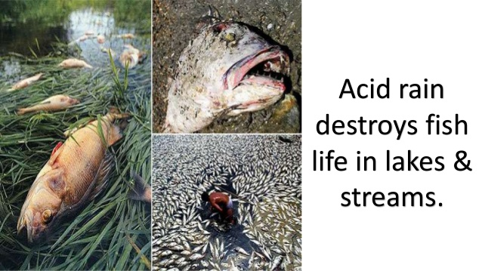
Silicon metal ingot: A recipe for environmental disaster.
Fugitive smelter emissions, Burnsville, Miss.
Effects of water as acid rain.
Greenhouse Gas effects.

